Slide 1
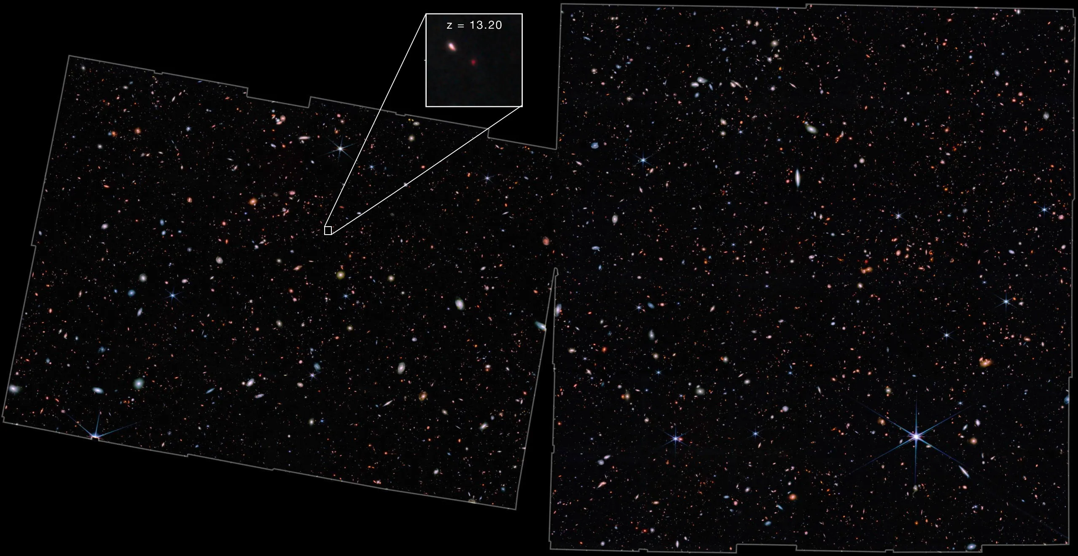
Hunting High Redshift Galaxies with JWST
Blythe Fernandes
Supervisor: Prof. Ross McLure
1 Arcmin
NASA, ESA, CSA, M. Zamani (ESA/Webb). "JWST Advanced Deep Extragalactic Survey (JADES)." Webb Space Telescope, December 09, 2022, https://webbtelescope.org/contents/media/images/01GKT0RRJBP5ZMJRMCQNPT8SXP?tag=planetary%20rings.
Notes:
- Introduce yourself
- For my Master’s:
- Looking at Emission lines from High Z Galaxies with JWST
- Left side of Cover Slide:
- JADES field
- I am been working
23s

Slide 2
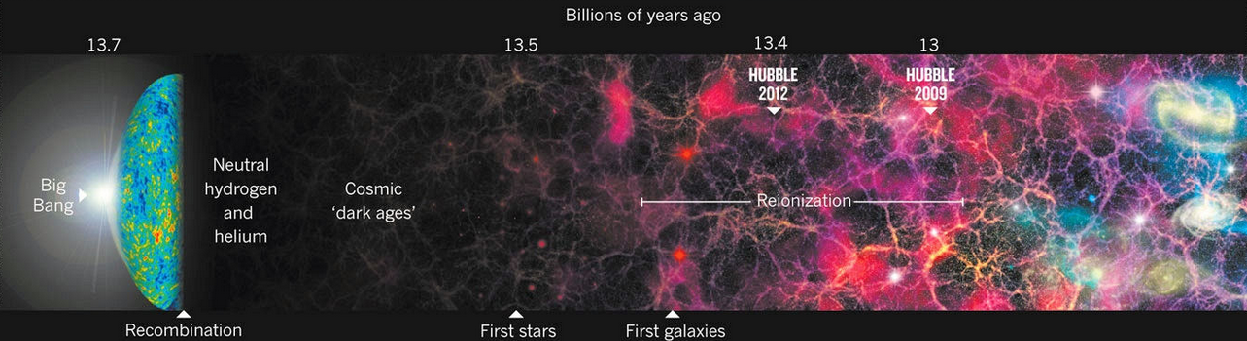
Motivation
R. Cowen. Galaxy formation: Cosmic dawn. Nature 497, 554–556 (2013). https://doi.org/10.1038/497554a
z ≈10
Want to better understand the Epoch of Cosmic Reionisation
Need to look further back in time
Probe high redshifts
Faint galaxies
HST could observe to z ≈ 10
Can observe further with JWST
Notes:
Motivation and Background:
Better Understand the Epoch of Cosmic Reionisation
We have a good understanding for when Cosmic Reionisation ended
But want to get a sense of when it roughly started
For this:
we need look into the distant past.
Therefore; probe high redshifts
With the HST:
Until about z = 10 could be probed
But want to understand:
The period when First Galaxies were formed
JWST is brilliant
It can go to higher redshifts;
(Thought to be at redshifts of 5 and 7 – Due to filters)
46s

Slide 3
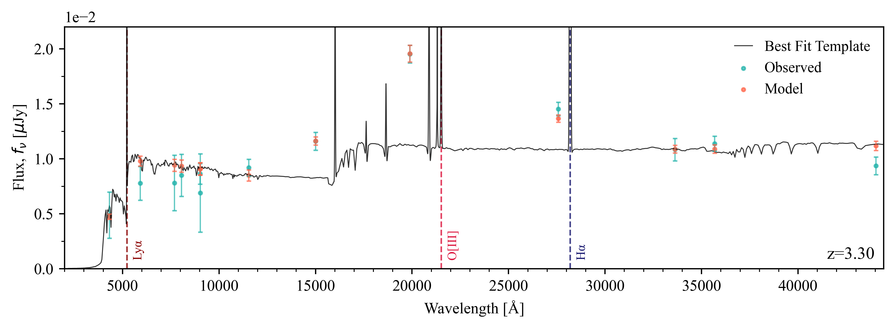
O[III] (5007 Å)
Hα (6563 Å)
Young galaxies
Very hot and blue
Produce a lot of ionising photons
Intensity is proportional to the number of ionising photon within a stellar population
Were there enough ionising photons produced to ionise universe?
Indicator - Star Formation Rate
Young stars born
Ionise Gas
Strong Ionosphere
Balances between Recombination and Ionisation
Recombination produces Hydrogen
Rest-frame Wavelengths
Notes:
2 main emission lines are H-alpha and O[III]
1:23

Slide 4
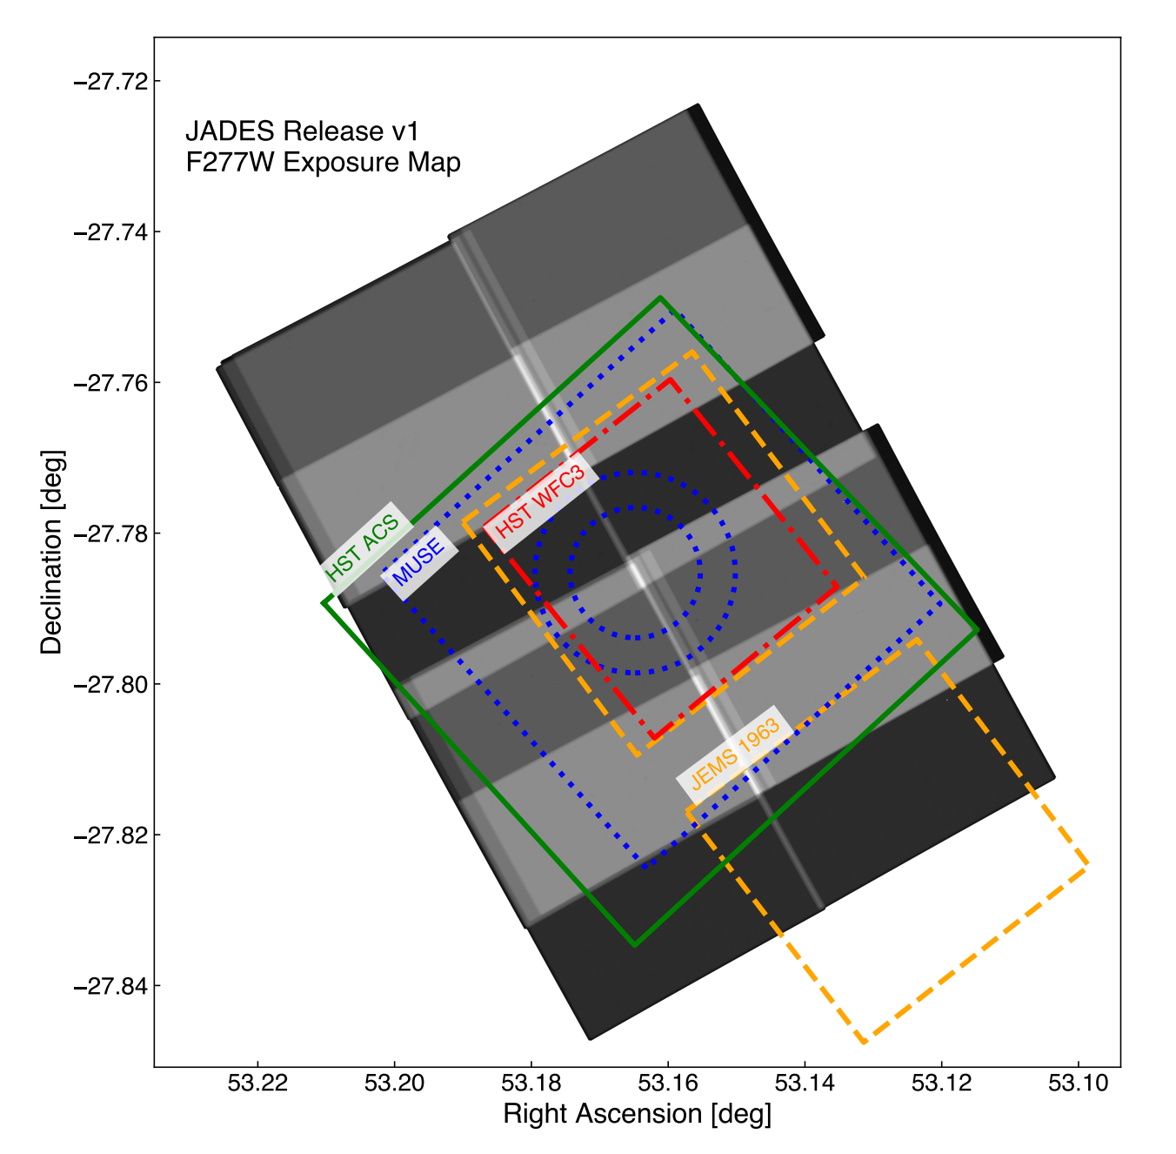
Chosen Field of View
M. J. Rieke et al., “JADES Initial Data Release for the Hubble Ultra Deep Field: Revealing the Faint Infrared Sky with Deep JWST NIRCam Imaging”, 269, 16, 16 (2023).
Commonly known as:
GOODS – South
Studied extensively for
Photometry
Spectroscopy
Analysis done with data from
NIRCam – Short and Long
HST ACS
Total Area of data in JADES survey is 25 arcmins
Notes:
Popularily known as:
GOODS – South
Has been studied extensively for
Photometry
Spectroscopy
Analysis done with data
NirCam – Short and Long
HST ACS
The plot:
Shows field of previous surveys in comparison to the JADES survey
HST sits within the chosen field
Used for analysis
Good distribution of Wavelengths to study with HST data
(Total Area of data in JADES survey is 25 arcmins.)
55s

Slide 5
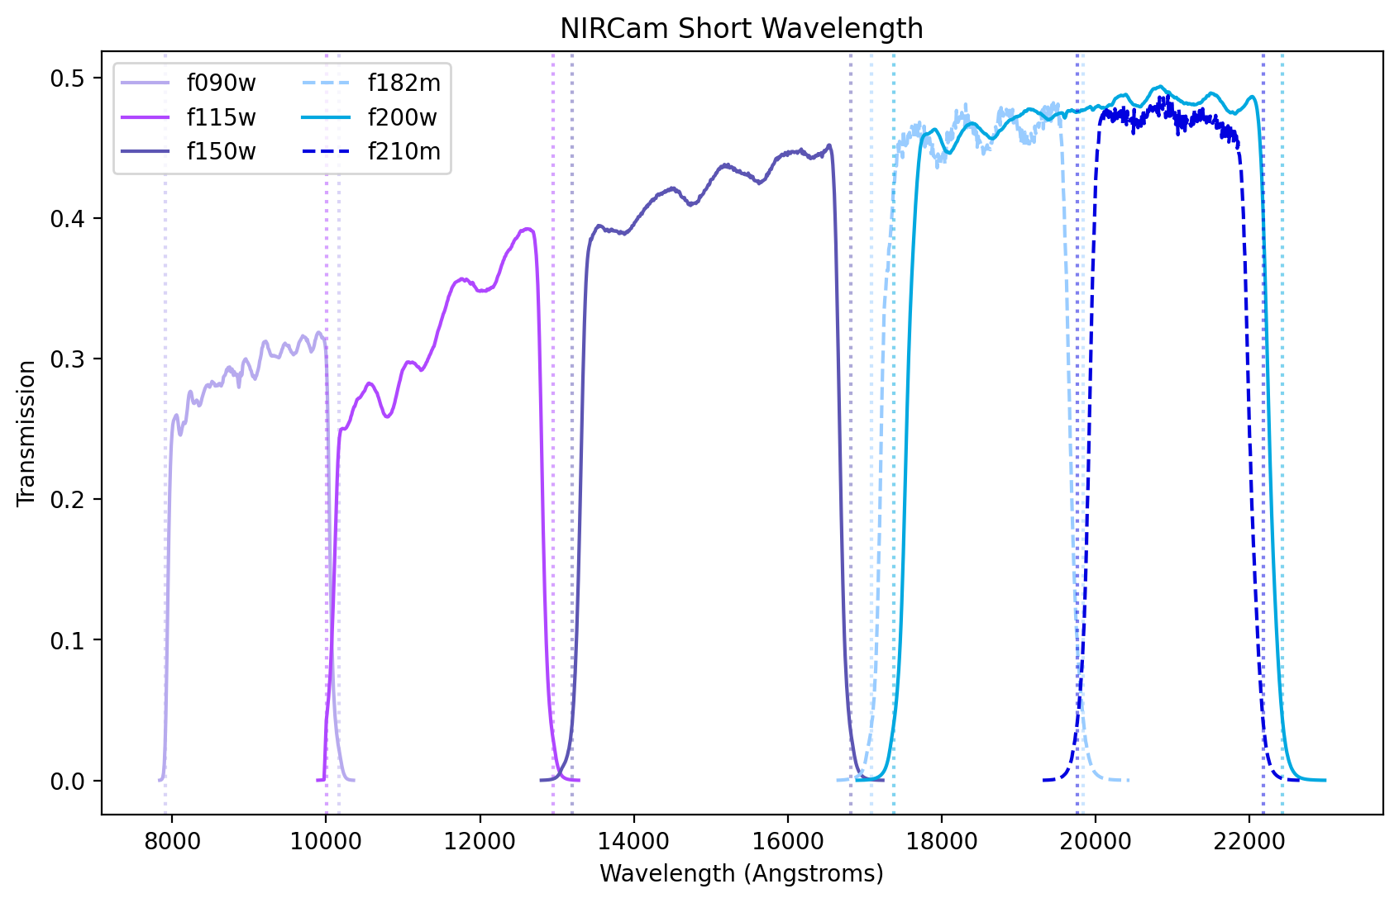
NIRCam Short Wavelength
Filter Transmission Curves
Notes:
Flux Transmission Curves for the JADES filters used in this project

Slide 6
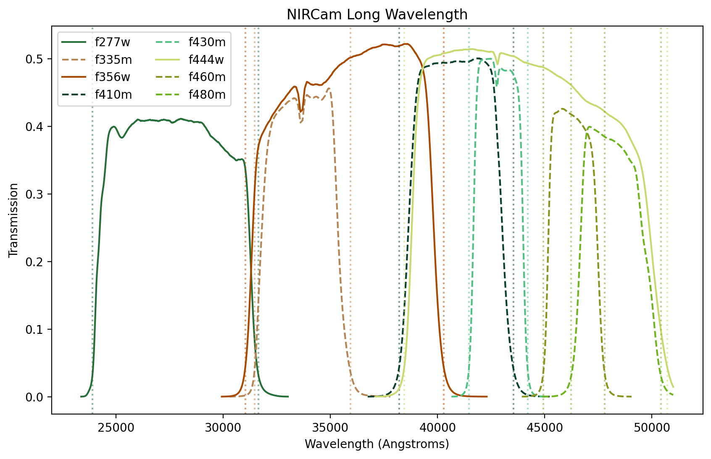
NIRCam Long Wavelength
Filter Transmission Curves

Slide 7
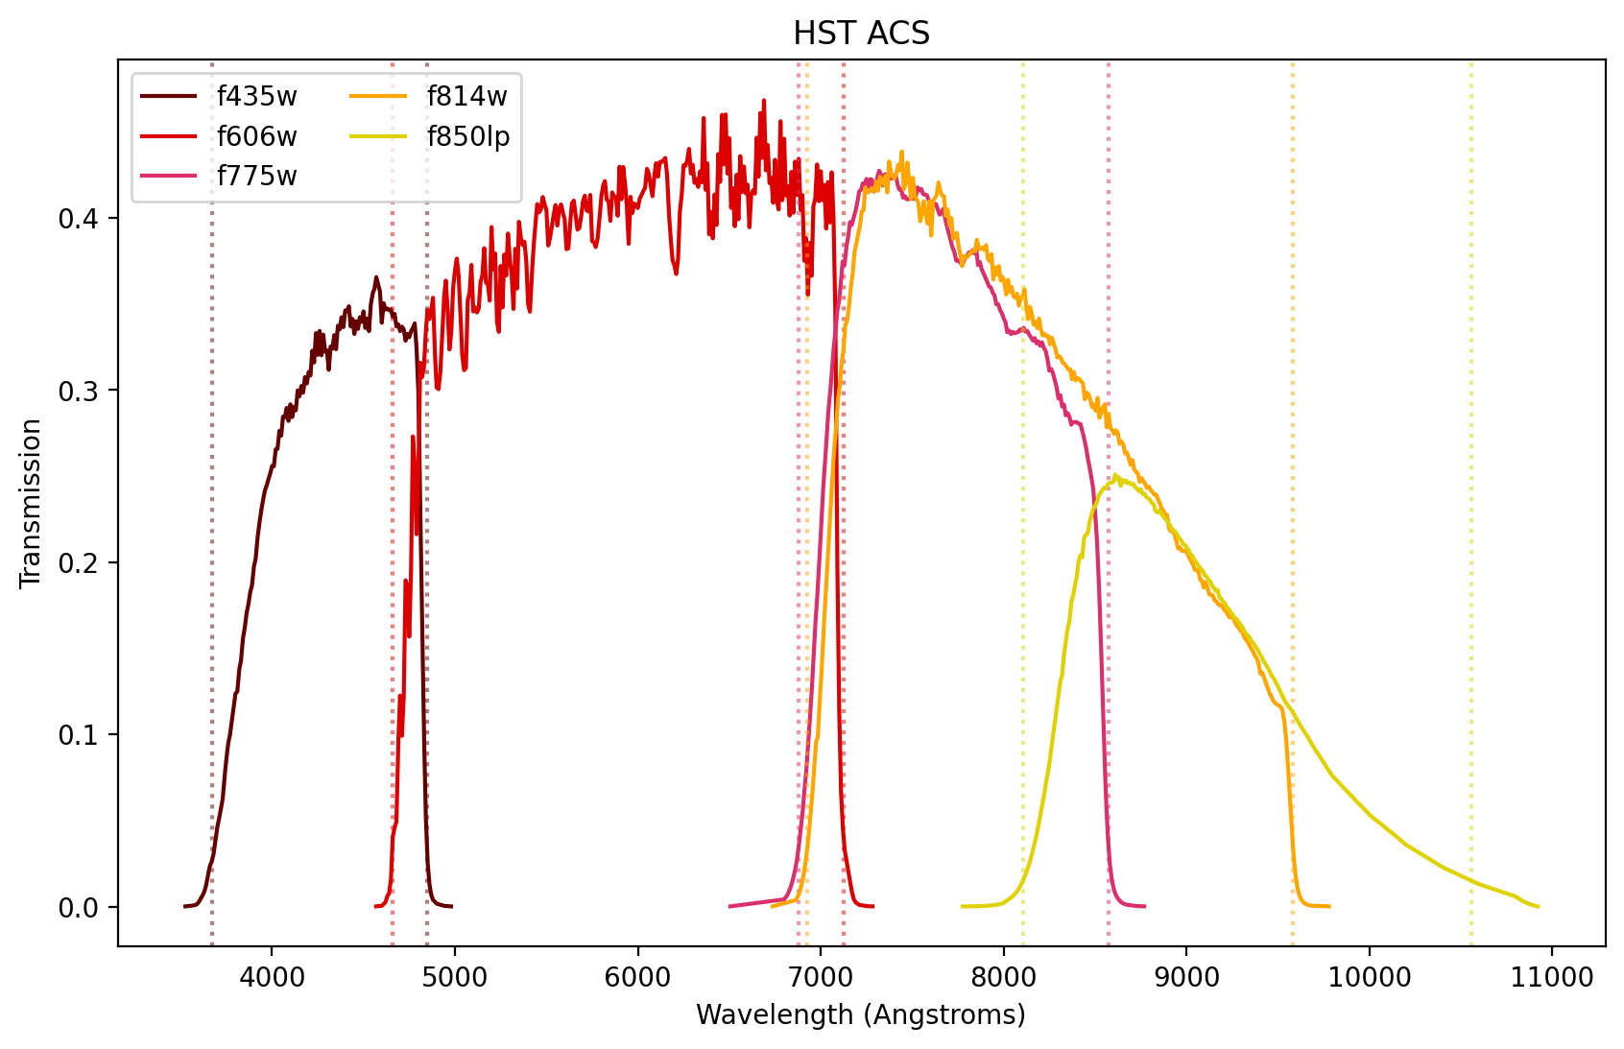
HST ACS
Filter Transmission Curves
Notes:
Flux Transmission Curves for HST Advanced Camera for Surveys (ACS)

Slide 8
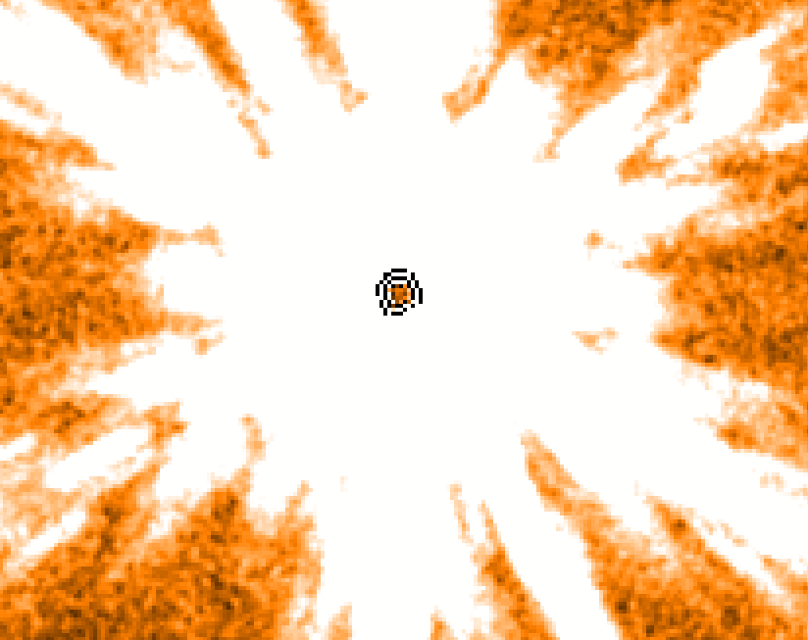
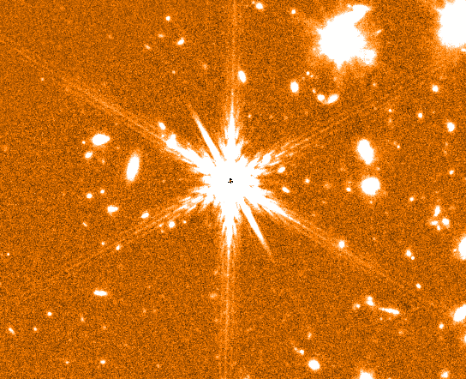
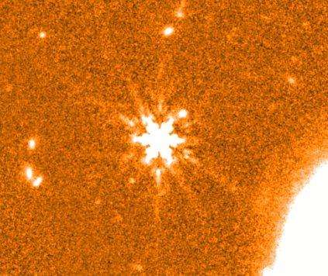
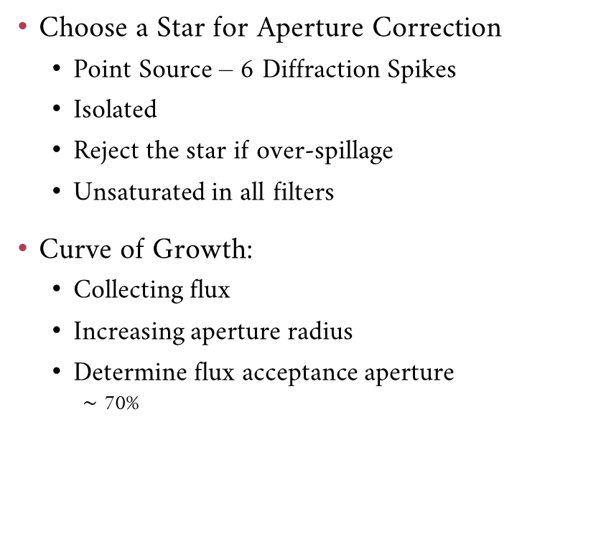
PSF Homogenisation
Choose a Star for Aperture Correction
Point Source – 6 Diffraction Spikes
Isolated
Reject the star if over-spillage
Unsaturated in all filters
Curve of Growth:
Collecting flux
Increasing aperture radius
Determine flux acceptance aperture
$\sim$ 70%
[Taken from JADES Survey]
[Taken from JADES Survey]
Notes:
First point of business:
Perform a PSF Homogenisation
Choose a Star for Aperture Correction
Has to Point Source –
Look for Diffraction Spikes
Galaxies would be more rounded
Light is coming from multiple sources
Isolated
Unsaturated in all filters
No Flux Spillage
Now produce Curve of Growth:
With the same single star
Increase radius - 0.05 step
Determine flux acceptance aperture
We said 70% (Next Slide)
PUT FIGURE LABELS
1:21s

Slide 9
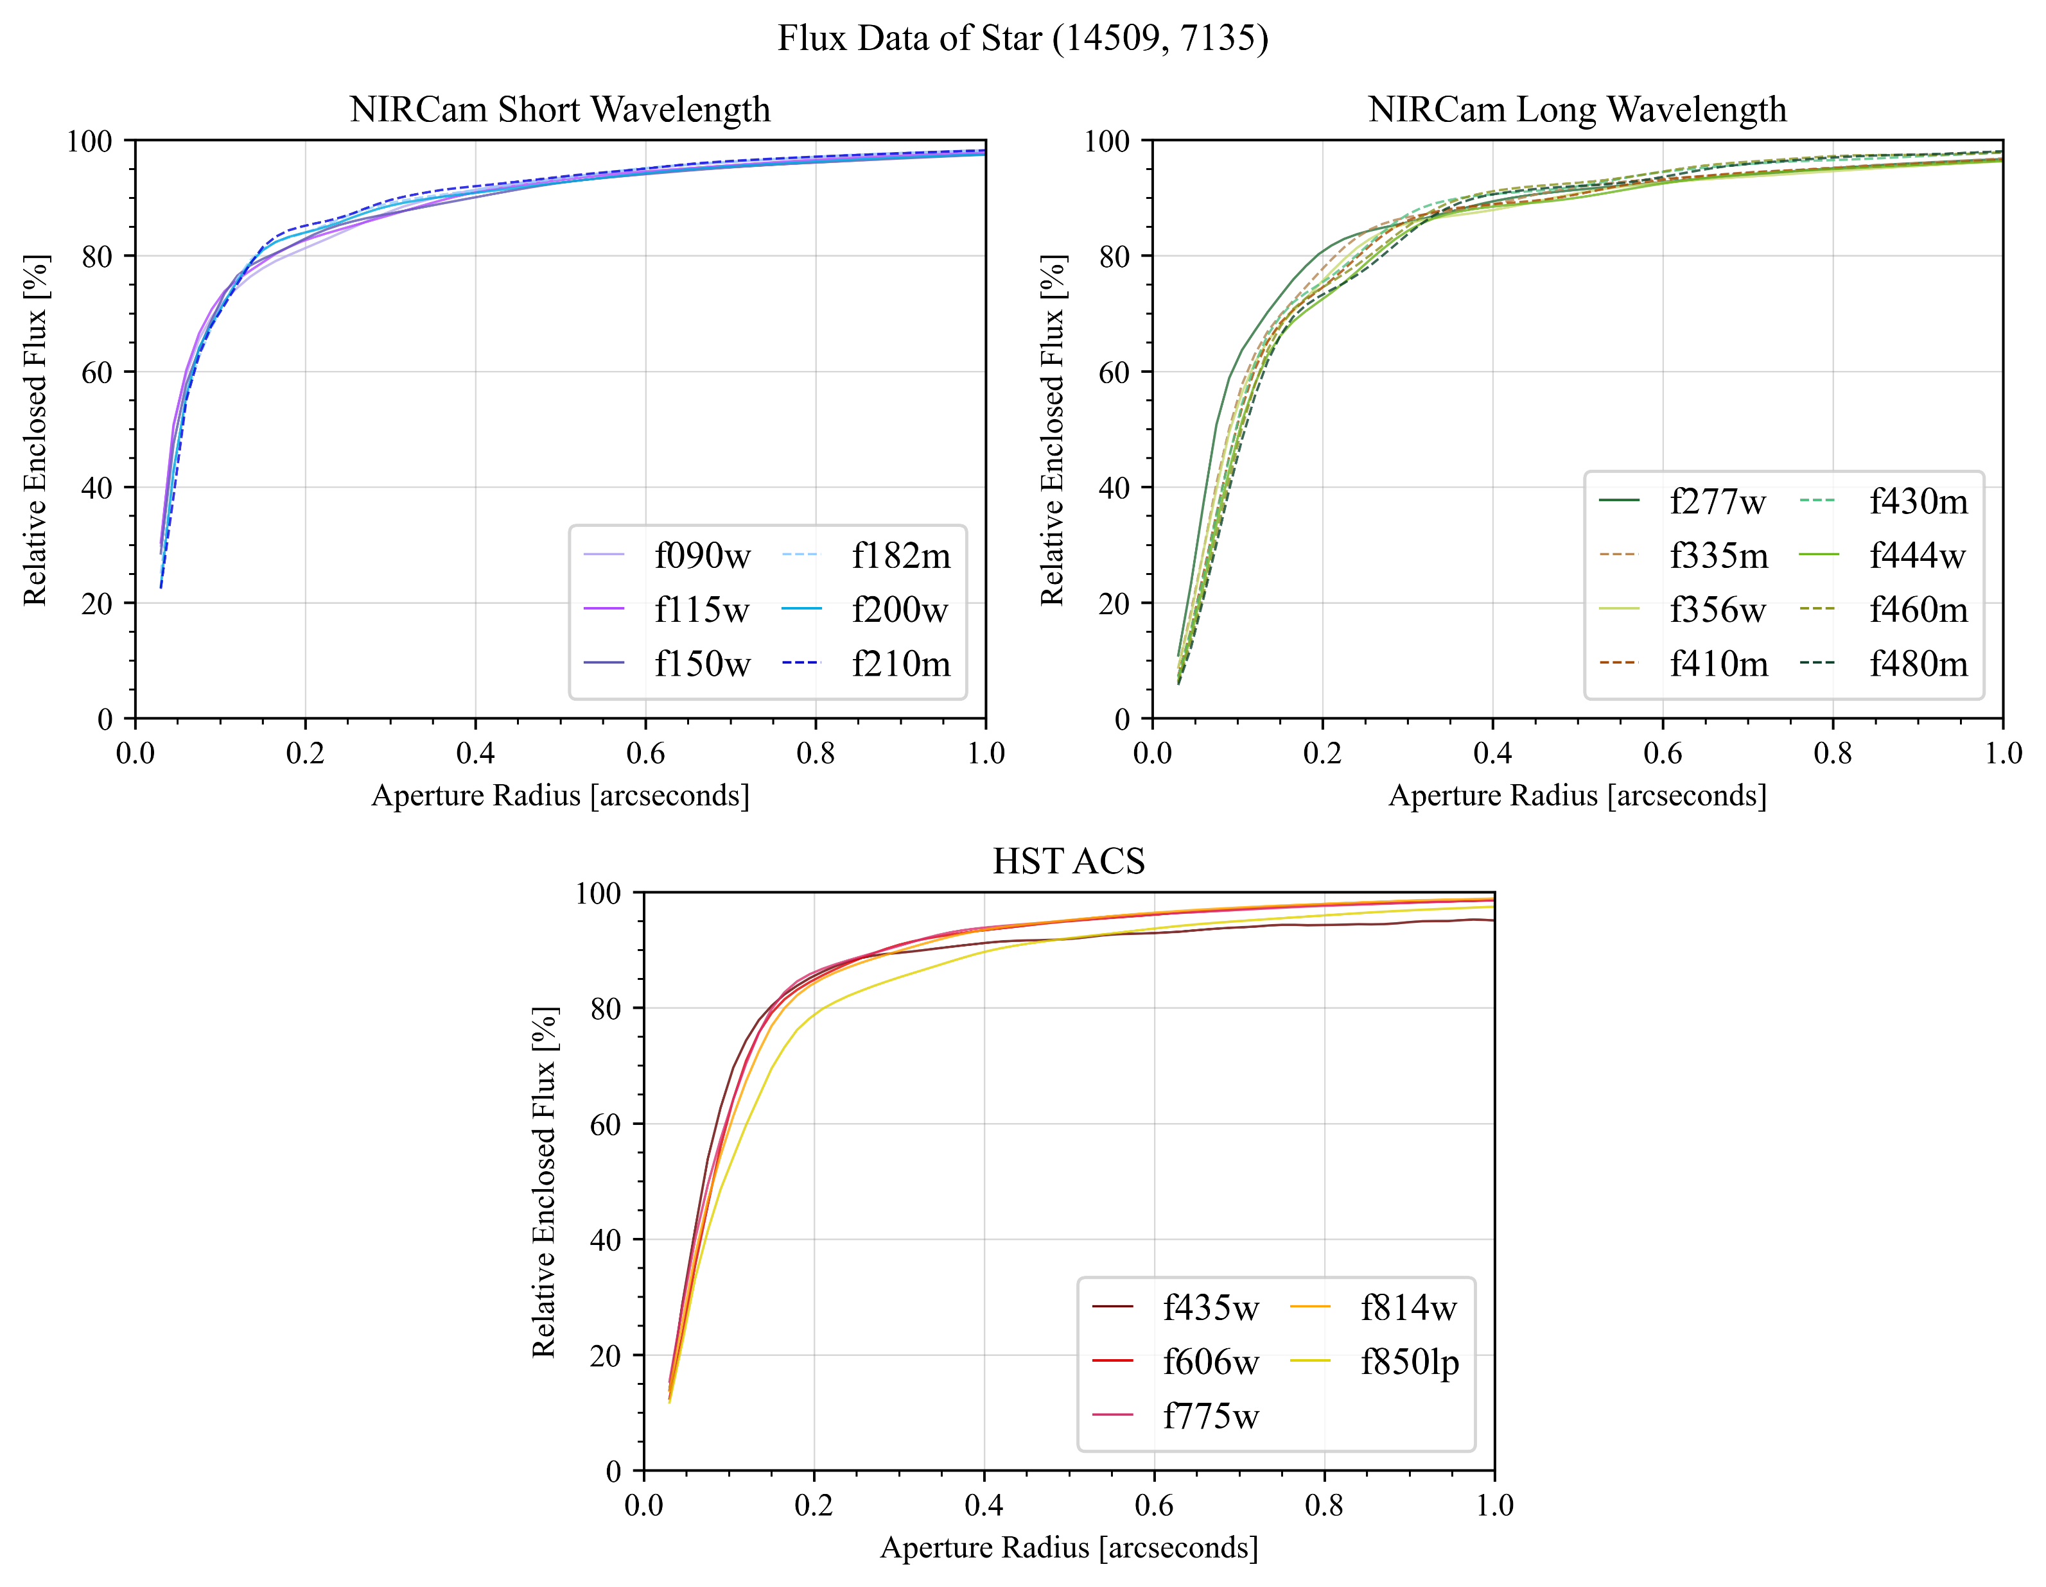
Curve of Growth of Star
Notes:
Curve of Growth:
Exponential Growth
Meaning Object Flux
Flattens out at the end
All object flux collected
Collecting sky noise in aperture
70% corresponds
But some of the curves are not all at 70%
Need to get the curves to be at 70%
Up or Down
For this:
Convolution is needed
PUT IN THE LINE FOR THE 70% PLEASE FOR THE LOVE OF GOD
54s

Slide 10
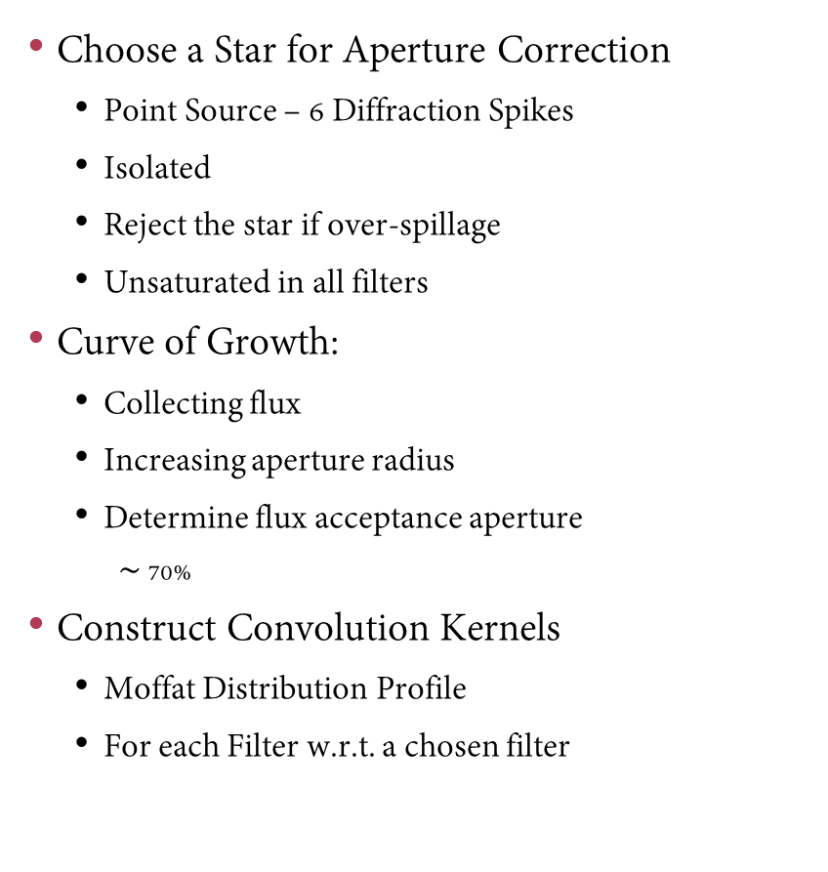
PSF Homogenisation
[Taken from JADES Survey]
Choose a Star for Aperture Correction
Point Source – 6 Diffraction Spikes
Isolated
Reject the star if over-spillage
Unsaturated in all filters
Curve of Growth:
Collecting flux
Increasing aperture radius
Determine flux acceptance aperture
$\sim$ 70%
Construct Convolution Kernels
Moffat Distribution Profile
For each Filter w.r.t. a chosen filter
Notes:
19

Slide 11
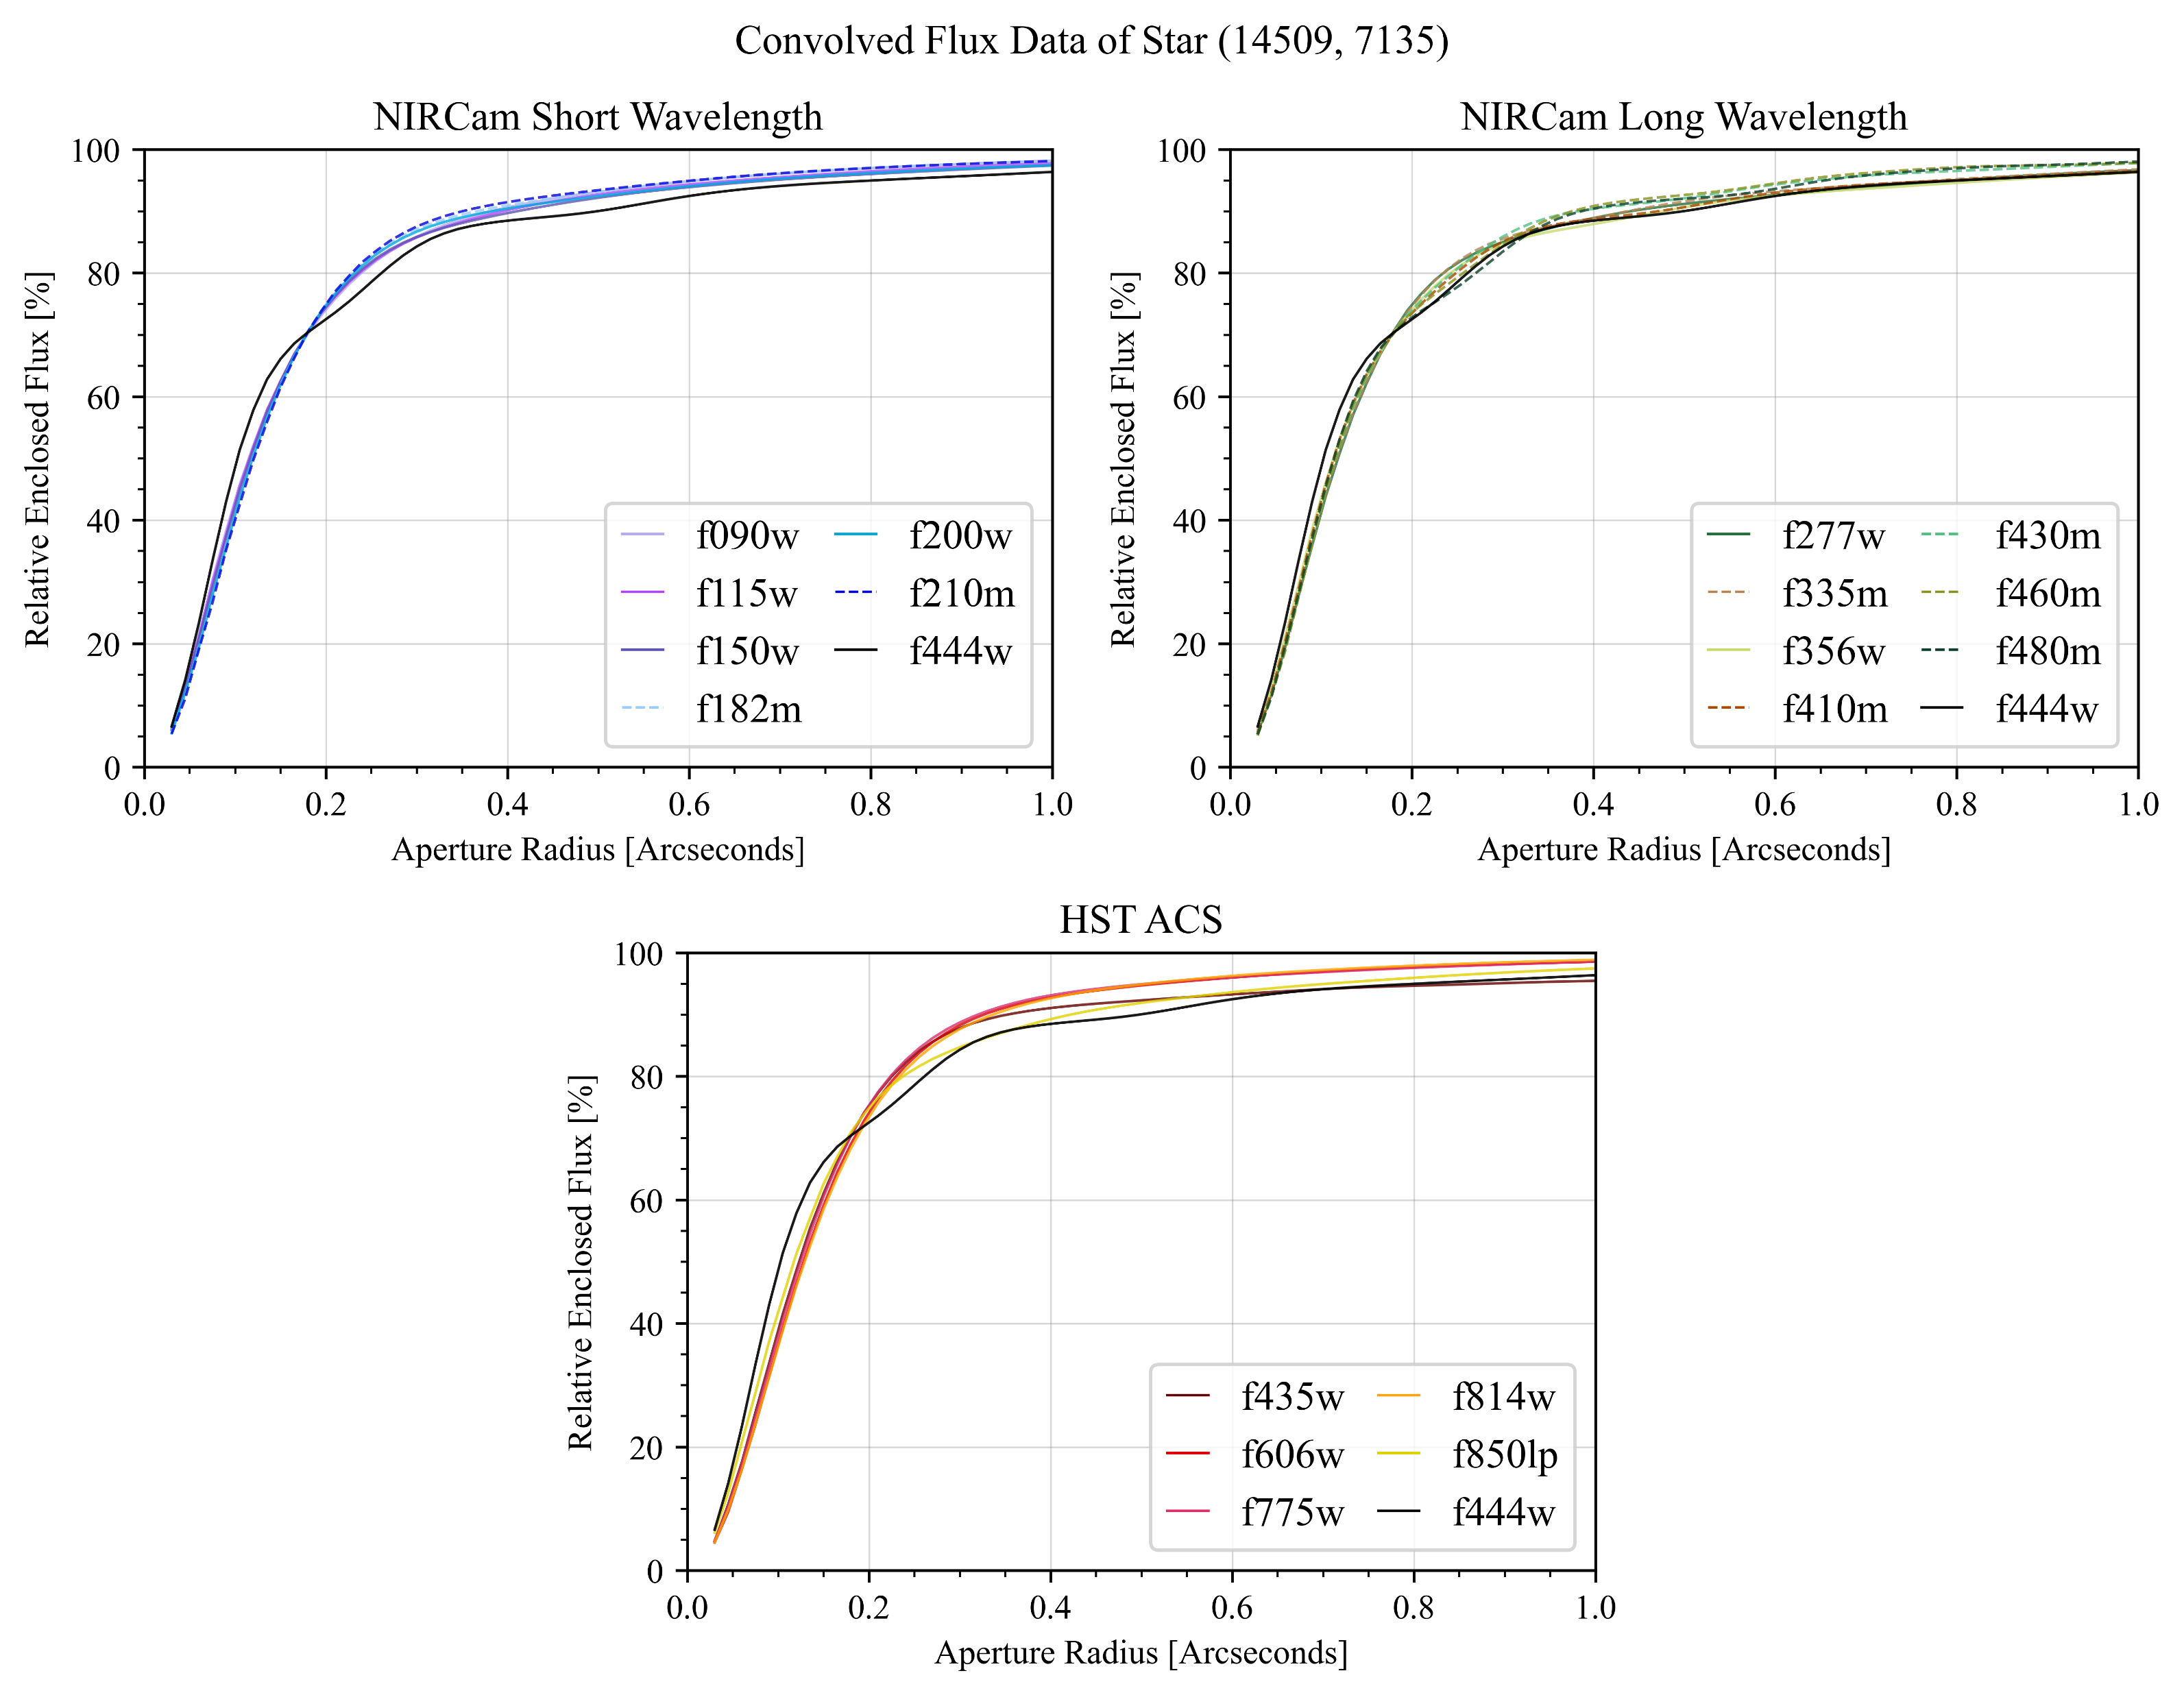
Curve of Growth of Star - Convolved
Notes:
Here:
Flux measurement doesn’t have a significant amount of sky noise

Slide 12
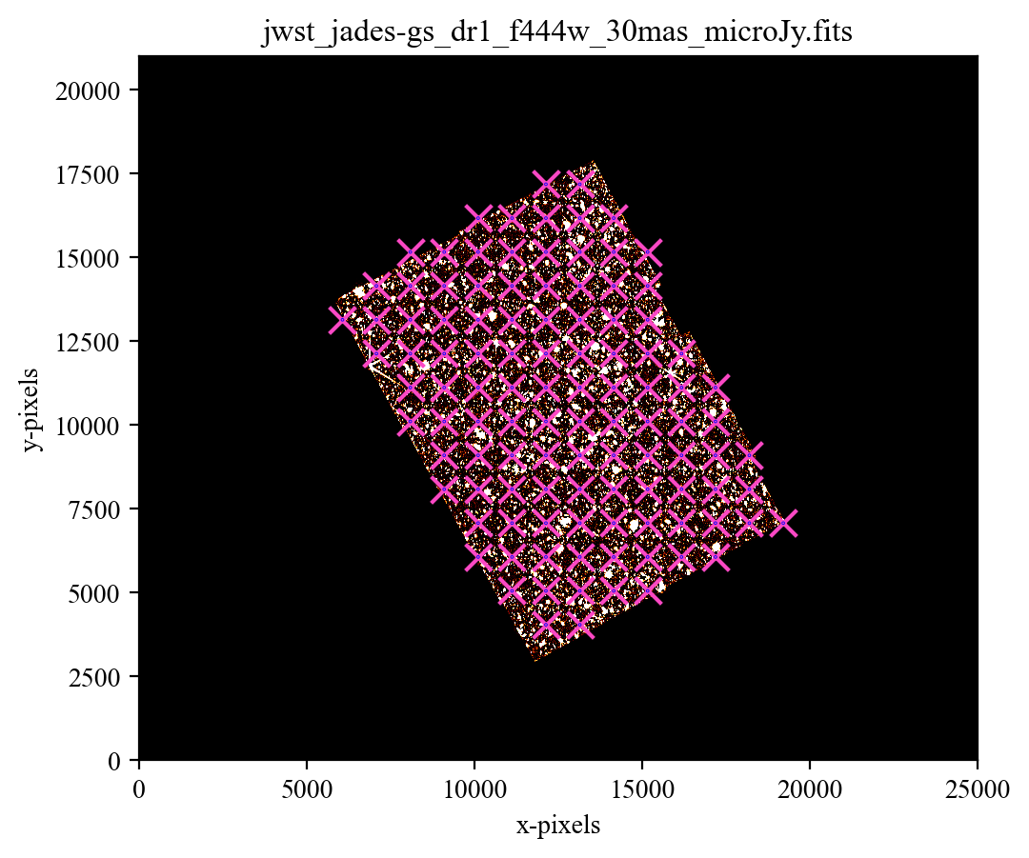
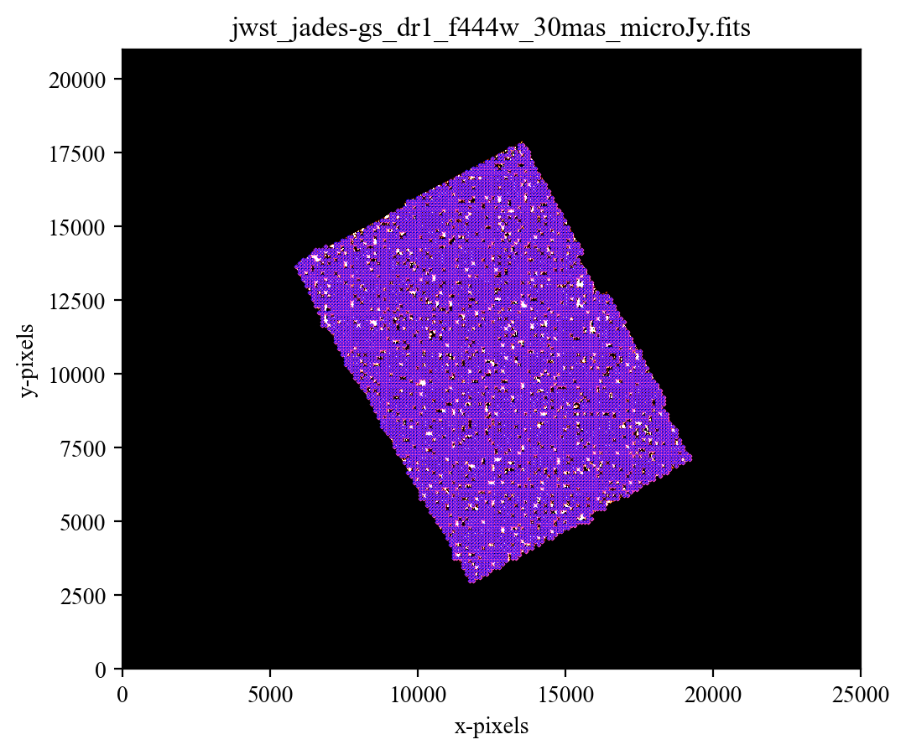
Noise Calibration
Gather Sky background noise:
With SEP (Source Extractor)
Place apertures on the image
Keep aperture spacing small enough to get appropriate measurements
Use Segmentation Map
Remove any apertures on objects
Expect sky noise distribution to be a Gaussian
Centred at 0
Notes:
Second Calibration:
To understand how sensitive the images are

Slide 13
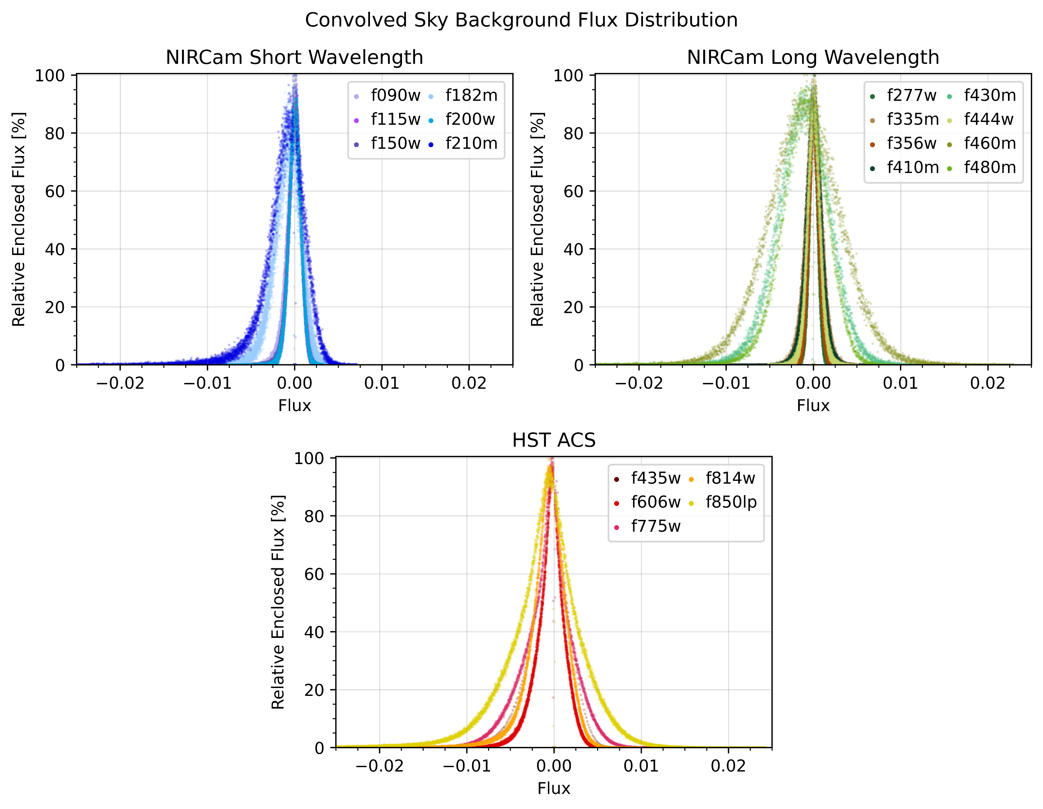
Sky Background Distribution

Slide 14
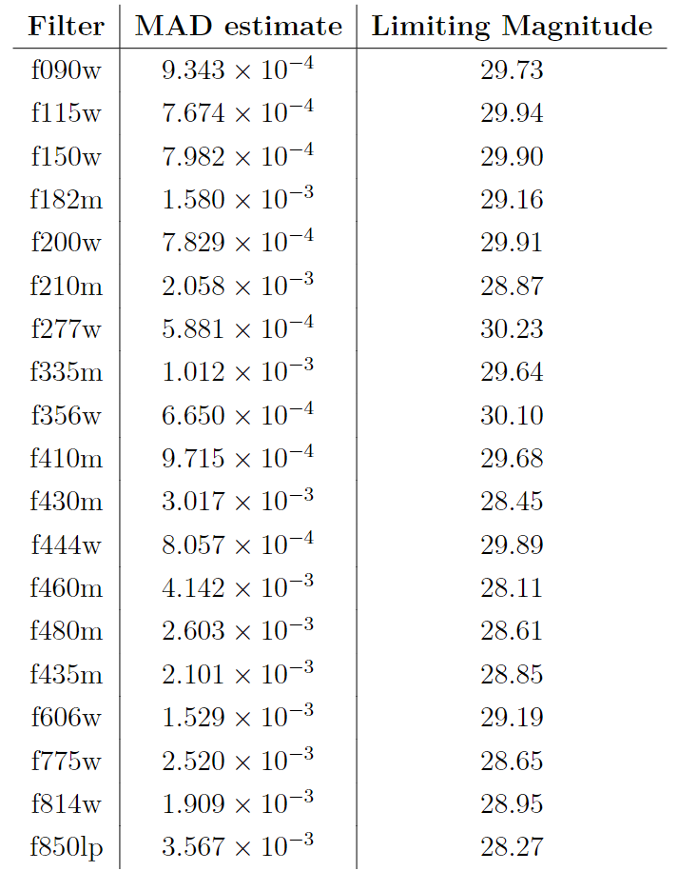
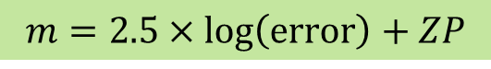
Calibration Results
MAD Estimator:
More Robust to Outliers
From Astropy
Limiting Magnitude in mJy
Zero-point set at 23.9 mJy
$$m=2.5×\log\left(\text{error}\right)+ZP$$
Notes:
Median absolute deviation

Slide 15
Science Goals
Using this calibration generate a Catalogue with sep
Filter Catalogue:
Remove any objects that are noise 5σ cut
Remove any objects with that considered too bright with the magnitude calculated in the f356w filter – This filter is mass sensitive that make; therefore, sensible choice
Run the Catalogue for Photometry Redshift
With eazypy (EAZY)
gbrammer/eazy-py: Pythonic photometric redshift tools based on EAZY (github.com)
Brammer, G. B., van Dokkum, P. G., and Coppi, P., “EAZY: A Fast, Public Photometric Redshift Code”, <i>The Astrophysical Journal</i>, vol. 686, no. 2, IOP, pp. 1503–1513, 2008. doi:10.1086/591786.
Trace Hα and O[III] emission lines

Slide 16
Thanks for Listening
Any Questions?

